Slide 1
BÀI 7 – THUẬT TOÁN
DI TRUYỀN
GENETIC ALGORITHMS

Slide 2
Genetic Algorithms
An Example Genetic Algorithm
Procedure GA{
t = 0;
Initialize P(t);
Evaluate P(t);
While (Not Done)
{
Parents(t) = Select_Parents(P(t));
Offspring(t) = Procreate(Parents(t));
Evaluate(Offspring(t));
P(t+1)= Select_Survivors(P(t),Offspring(t));
t = t + 1;
}

Slide 3
Genetic Algorithms
Representation of Candidate Solutions
GAs on primarily two types of representations:
  Binary-Coded
  Real-Coded
Binary-Coded GAs must decode a chromosome into a CS, evaluate the CS and return the resulting fitness back to the binary-coded chromosome representing the evaluated CS.

Slide 4
Genetic Algorithms:
Binary-Coded Representations
For Example, let’s say that we are trying to optimize the following function,
  f(x) = x²
  for 2 ≥ x ≥ 1
If we were to use binary-coded representations we would first need to develop a mapping function form our genotype representation (binary string) to our phenotype representation (our CS). This can be done using the following mapping function:
  d(ub,lb,l,chrom) = (ub-lb) decode(chrom)/2^{l}-1 + lb

Slide 5
Genetic Algorithms:
Binary-Coded Representations
d(ub,lb,l,c) = (ub-lb) decode(c)/2^{l}-1 + lb , where
  ub = 2,
  lb = 1,
  l = the length of the chromosome in bits
  c = the chromosome
The parameter, l, determines the accuracy (and resolution of our search).
What happens when l is increased (or decreased)?

Slide 6
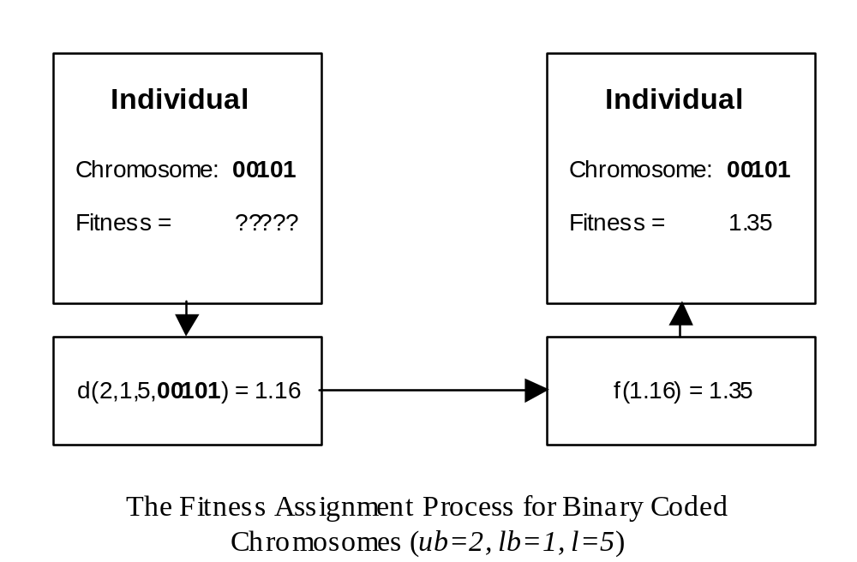
Genetic Algorithms:
Binary Coded Representations

Slide 7
Genetic Algorithms:
Real-Coded Representations
Real-Coded GAs can be regarded as GAs that operate on the actual CS (phenotype).
For Real-Coded GAs, no genotype-to-phenotype mapping is needed.

Slide 8
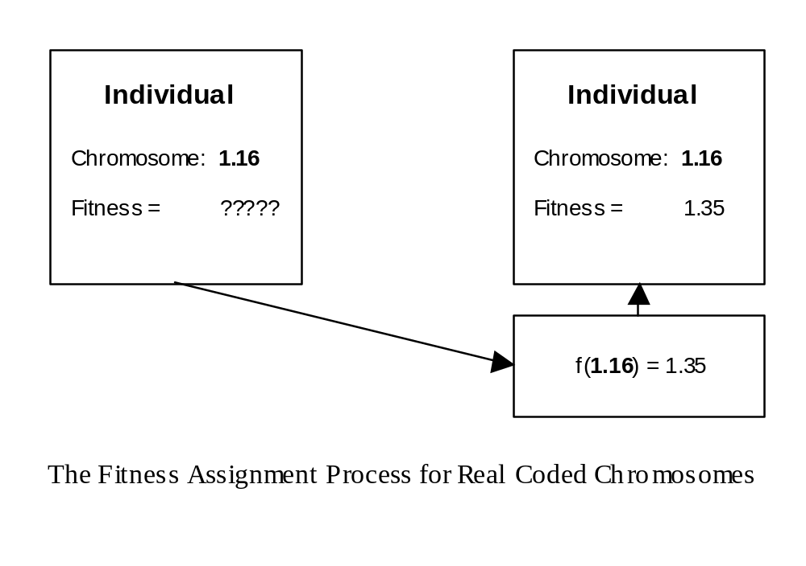
Genetic Algorithms:
Real-Coded Representations

Slide 9
Genetic Algorithms:
Parent Selection Methods
An Example Genetic Algorithm
Procedure GA{
t = 0;
Initialize P(t);
Evaluate P(t);
While (Not Done)
{
Parents(t) = Select_Parents(P(t));
Offspring(t) = Procreate(Parents(t));
Evaluate(Offspring(t));
P(t+1)= Select_Survivors(P(t),Offspring(t));
t = t + 1;
}

Slide 10
Genetic Algorithms:
Parent Selection Methods
GA researchers have used a number of parent selection methods. Some of the more popular methods are:
  Proportionate Selection
  Linear Rank Selection
  Tournament Selection

Slide 11
Genetic Algorithms:
Proportionate Selection
In Proportionate Selection, individuals are assigned a probability of being selected based on their fitness:
  p_{i} = f_{i} / Σf_{j}
  Where p_{i} is the probability that individual i will be selected,
  f_{i} is the fitness of individual i, and
  Σf_{j} represents the sum of all the fitnesses of the individuals with the population.
This type of selection is similar to using a roulette wheel where the fitness of an individual is represented as proportionate slice of wheel. The wheel is then spun and the slice underneath the wheel when it stops determine which individual becomes a parent.

Slide 12
Genetic Algorithms:
Proportionate Selection
There are a number of disadvantages associated with using proportionate selection:
  Cannot be used on minimization problems,
  Loss of selection pressure (search direction) as population converges,
  Susceptible to Super Individuals

Slide 13
Genetic Algorithms:
Linear Rank Selection
In Linear Rank selection, individuals are assigned subjective fitness based on the rank within the population:
  sf_{i} = (P-r_{i})(max-min)/(P-1) + min
  Where r_{i} is the rank of indvidual i,
  P is the population size,
  Max represents the fitness to assign to the best individual,
  Min represents the fitness to assign to the worst individual.
p_{i} = sf_{i} / Σsf_{j} Roulette Wheel Selection can be performed using the subjective fitnesses.
One disadvantage associated with linear rank selection is that the population must be sorted on each cycle.

Slide 14
Genetic Algorithms:
Tournament Selection
In Tournament Selection, q individuals are randomly selected from the population and the best of the q individuals is returned as a parent.
Selection Pressure increases as q is increased and decreases a q is decreased.

Slide 15
Genetic Algorithms:
Genetic Procreation Operators
An Example Genetic Algorithm
Procedure GA{
t = 0;
Initialize P(t);
Evaluate P(t);
While (Not Done)
{
Parents(t) = Select_Parents(P(t));
Offspring(t) = Procreate(Parents(t));
Evaluate(Offspring(t));
P(t+1)= Select_Survivors(P(t),Offspring(t));
t = t + 1;
}

Slide 16
Genetic Algorithms:
Genetic Procreation Operators
Genetic Algorithms typically use two types of operators:
  Crossover (Sexual Recombination), and
  Mutation (Asexual)
Crossover is usually the primary operator with mutation serving only as a mechanism to introduce diversity in the population.
However, when designing a GA to solve a problem it is not uncommon that one will have to develop unique crossover and mutation operators that take advantage of the structure of the CSs comprising the search space.

Slide 17
Genetic Algorithms:
Genetic Procreation Operators
However, there are a number of crossover operators that have been used on binary and real-coded GAs:
  Single-point Crossover,
  Two-point Crossover,
  Uniform Crossover

Slide 18
Genetic Algorithms:
Single-Point Crossover
Given two parents, single-point crossover will generate a cut-point and recombines the first part of first parent with the second part of the second parent to create one offspring.
Single-point crossover then recombines the second part of the first parent with the first part of the second parent to create a second offspring.

Slide 19
Genetic Algorithms:
Single-Point Crossover
Example:
  Parent 1: X X | X X X X X
  Parent 2: Y Y | Y Y Y Y Y
  Offspring 1: X X Y Y Y Y Y
  Offspring 2: Y Y X X X X X

Slide 20
Genetic Algorithms:
Two-Point Crossover
Two-Point crossover is very similar to single-point crossover except that two cut-points are generated instead of one.

Slide 21
Genetic Algorithms:
Two-Point Crossover
Example:
  Parent 1: X X | X X X | X X
  Parent 2: Y Y | Y Y Y | Y Y
  Offspring 1: X X Y Y Y X X
  Offspring 2: Y Y X X X Y Y

Slide 22
Genetic Algorithms:
Uniform Crossover
In Uniform Crossover, a value of the first parent’s gene is assigned to the first offspring and the value of the second parent’s gene is to the second offspring with probability 0.5.
With probability 0.5 the value of the first parent’s gene is assigned to the second offspring and the value of the second parent’s gene is assigned to the first offspring.

Slide 23
Genetic Algorithms:
Uniform Crossover
Example:
  Parent 1: X X X X X X X
  Parent 2: Y Y Y Y Y Y Y
  Offspring 1: X Y X Y Y X Y
  Offspring 2: Y X Y X X Y X

Slide 24
Genetic Algorithms:
Real-Coded Crossover Operators
For Real-Coded representations there exist a number of other crossover operators:
  Mid-Point Crossover,
  Flat Crossover (BLX-0.0),
  BLX-0.5

Slide 25
Genetic Algorithms:
Mid-Point Crossover
Given two parents where X and Y represent a floating point number:
  Parent 1: X
  Parent 2: Y
  Offspring: (X+Y)/2
If a chromosome contains more than one gene, then this operator can be applied to each gene with a probability of P_{mp}.

Slide 26
Genetic Algorithms:
Flat Crossover (BLX-0.0)
Flat crossover was developed by Radcliffe (1991)
Given two parents where X and Y represent a floating point number:
  Parent 1: X
  Parent 2: Y
  Offspring: rnd(X,Y)
Of course, if a chromosome contains more than one gene then this operator can be applied to each gene with a probability of P_{blx-0.0}.

Slide 27
Genetic Algorithms:
BLX-α
Developed by Eshelman & Schaffer (1992)
Given two parents where X and Y represent a floating point number, and where X < Y:
  Parent 1: X
  Parent 2: Y
  Let Δ = α(Y-X), where α = 0.5
  Offspring: rnd(X-Δ, Y+ Δ)
Of course, if a chromosome contains more than one gene then this operator can be applied to each gene with a probability of P_{blx-α}.

Slide 28
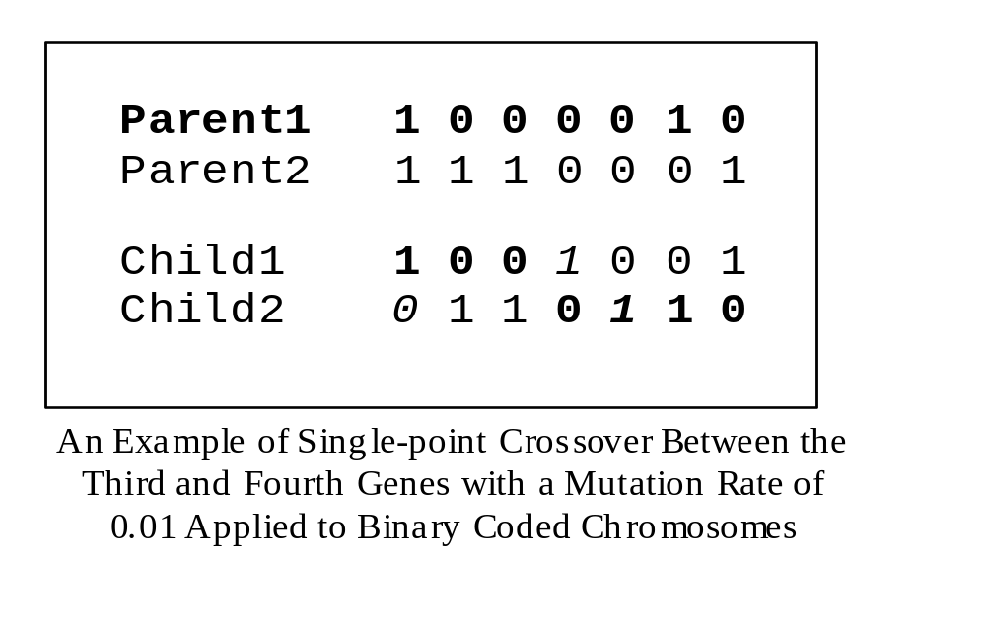
Genetic Algorithms:
Mutation (Binary-Coded)
In Binary-Coded GAs, each bit in the chromosome is mutated with probability p_{bm} known as the mutation rate.

Slide 29
Genetic Algorithms:
Mutation (Real-Coded)
In real-coded GAs, Gaussian mutation can be used.
For example, BLX-0.0 Crossover with Gaussian mutation.
Given two parents where X and Y represent a floating point number:
  Parent 1: X
  Parent 2: Y
  Offspring: rnd(X,Y) + σN(0,1)

Slide 30
Genetic Algorithm:
Selecting Who Survives
An Example Genetic Algorithm
Procedure GA{
t = 0;
Initialize P(t);
Evaluate P(t);
While (Not Done)
{
Parents(t) = Select_Parents(P(t));
Offspring(t) = Procreate(Parents(t));
Evaluate(Offspring(t));
P(t+1)= Select_Survivors(P(t),Offspring(t));
t = t + 1;
}

Slide 31
Genetic Algorithms:
Selection Who Survives
Basically, there are two types of GAs commonly used.
These GAs are characterized by the type of replacement strategies they use.
A Generational GA uses a (μ,μ) replacement strategy where the offspring replace the parents.
A Steady-State GA usually will select two parents, create 1-2 offspring which will replace the 1-2 worst individuals in the current population even if the offspring are worse than the individuals they replace.
This slightly different than (μ+1) or (μ+2) replacement.

Slide 32
Genetic Algorithm:
Example by Hand
Now that we have an understanding of the various parts of a GA let’s evolve a simple GA (SGA) by hand.
A SGA is :
  binary-coded,
  Uses proportionate selection
  uses single-point crossover (with a crossover usage rate between 0.6-1.0),
  uses a small mutation rate, and
  is generational.

Slide 33
Genetic Algorithms:
Example
The SGA for our example will use:
  A population size of 6,
  A crossover usage rate of 1.0, and
  A mutation rate of 1/7.
Let’s try to solve the following problem
  f(x) = x², where -2.0 ≤ x ≤ 2.0,
  Let l = 7, therefore our mapping function will be
    d(2,-2,7,c) = 4*decode(c)/127 - 2

Slide 34
Genetic Algorithms:
An Example Run (by hand)
Randomly Generate an Initial Population
Genotype Phenotype Fitness
Person 1: 1001010 0.331 Fit: ?
Person 2: 0100101 - 0.835 Fit: ?
Person 3: 1101010 1.339 Fit: ?
Person 4: 0110110 - 0.300 Fit: ?
Person 5: 1001111 0.488 Fit: ?
Person 6: 0001101 - 1.591 Fit: ?

Slide 35
Genetic Algorithms:
An Example Run (by hand)
Evaluate Population at t=0
Genotype Phenotype Fitness
Person 1: 1001010 0.331 Fit: 0.109
Person 2: 0100101 - 0.835 Fit: 0.697
Person 3: 1101010 1.339 Fit: 1.790
Person 4: 0110110 - 0.300 Fit: 0.090
Person 5: 1001111 0.488 Fit: 0.238
Person 6: 0001101 - 1.591 Fit: 2.531

Slide 36
Genetic Algorithms:
An Example Run (by hand)
Select Six Parents Using the Roulette Wheel
Genotype Phenotype Fitness
Person 6: 0001101 - 1.591 Fit: 2.531
Person 3: 1101010 1.339 Fit: 1.793
Person 5: 1001111 0.488 Fit: 0.238
Person 6: 0001101 - 1.591 Fit: 2.531
Person 2: 0100101 - 0.835 Fit: 0.697
Person 1: 1001010 0.331 Fit: 0.109

Slide 37
Genetic Algorithms:
An Example Run (by hand)
Create Offspring 1 & 2 Using Single-Point Crossover
Genotype Phenotype Fitness
Person 6: 00|01101 - 1.591 Fit: 2.531
Person 3: 11|01010 1.339 Fit: 1.793
Child 1 : 0001010 - 1.685 Fit: ?
Child 2 : 1101101 1.433 Fit: ?

Slide 38
Genetic Algorithms:
An Example Run (by hand)
Create Offspring 3 & 4
Genotype Phenotype Fitness
Person 5: 1001|111 0.488 Fit: 0.238
Person 6: 0001|101 - 1.591 Fit: 2.531
Child 3 : 1011100 0.898 Fit: ?
Child 4 : 0001011 - 1.654 Fit: ?

Slide 39
Genetic Algorithms:
An Example Run (by hand)
Create Offspring 5 & 6
Genotype Phenotype Fitness
Person 2: 010|0101 - 0.835 Fit: 0.697
Person 1: 100|1010 0.331 Fit: 0.109
Child 5 : 1101010 1.339 Fit: ?
Child 6 : 1010101 0.677 Fit: ?

Slide 40
Genetic Algorithms:
An Example Run (by hand)
Evaluate the Offspring
Genotype Phenotype Fitness
Child 1 : 0001010 - 1.685 Fit: 2.839
Child 2 : 1101101 1.433 Fit: 2.054
Child 3 : 1011100 0.898 Fit: 0.806
Child 4 : 0001011 - 1.654 Fit: 2.736
Child 5 : 1101010 1.339 Fit: 1.793
Child 6 : 1010101 0.677 Fit: 0.458

Slide 41
Genetic Algorithms:
An Example Run (by hand)
Population at t=0
Genotype Phenotype Fitness
Person 1: 1001010 0.331 Fit: 0.109
Person 2: 0100101 - 0.835 Fit: 0.697
Person 3: 1101010 1.339 Fit: 1.793
Person 4: 0110110 - 0.300 Fit: 0.090
Person 5: 1001111 0.488 Fit: 0.238
Person 6: 0001101 - 1.591 Fit: 2.531
Is Replaced by:
Genotype Phenotype Fitness
Child 1 : 0001010 - 1.685 Fit: 2.839
Child 2 : 1101101 1.433 Fit: 2.053
Child 3 : 1011100 0.898 Fit: 0.806
Child 4 : 0001011 - 1.654 Fit: 2.736
Child 5 : 1101010 1.339 Fit: 1.793
Child 6 : 1010101 0.677 Fit: 0.458

Slide 42
Genetic Algorithms:
An Example Run (by hand)
Population at t=1
Genotype Phenotype Fitness
Person 1: 0001010 - 1.685 Fit: 2.839
Person 2: 1101101 1.433 Fit: 2.054
Person 3: 1011100 0.898 Fit: 0.806
Person 4: 0001011 - 1.654 Fit: 2.736
Person 5: 1101010 1.339 Fit: 1.793
Person 6: 1010101 0.677 Fit: 0.458

Slide 43
Genetic Algorithms:
An Example Run (by hand)
The Process of:
  Selecting six parents,
  Allowing the parents to create six offspring,
  Mutating the six offspring,
  Evaluating the offspring, and
  Replacing the parents with the offspring
Is repeated until a stopping criterion has been reached.

Slide 44
Genetic Algorithms:
An Example Run (Steady-State GA)
Randomly Generate an Initial Population
Genotype Phenotype Fitness
Person 1: 1001010 0.331 Fit: ?
Person 2: 0100101 - 0.835 Fit: ?
Person 3: 1101010 1.339 Fit: ?
Person 4: 0110110 - 0.300 Fit: ?
Person 5: 1001111 0.488 Fit: ?
Person 6: 0001101 - 1.591 Fit: ?

Slide 45
Genetic Algorithms:
An Example Run (Steady-State GA)
Evaluate Population at t=0
Genotype Phenotype Fitness
Person 1: 1001010 0.331 Fit: 0.109
Person 2: 0100101 - 0.835 Fit: 0.697
Person 3: 1101010 1.339 Fit: 1.790
Person 4: 0110110 - 0.300 Fit: 0.090
Person 5: 1001111 0.488 Fit: 0.238
Person 6: 0001101 - 1.591 Fit: 2.531

Slide 46
Genetic Algorithms:
An Example Run (Steady-State GA)
Select 2 Parents and Create 2 Using Single-Point Crossover
Genotype Phenotype Fitness
Person 6: 00|01101 - 1.591 Fit: 2.531
Person 3: 11|01010 1.339 Fit: 1.793
Child 1 : 0001010 - 1.685 Fit: ?
Child 2 : 1101101 1.433 Fit: ?

Slide 47
Genetic Algorithms:
An Example Run (Steady-State GA)
Evaluate the Offspring
Genotype Phenotype Fitness
Child 1 : 0001010 - 1.685 Fit: 2.839
Child 2 : 1101101 1.433 Fit: 2.054

Slide 48
Genetic Algorithms:
An Example Run (Steady-State GA)
Find the two worst individuals to be replaced
Genotype Phenotype Fitness
Person 1: 1001010 0.331 Fit: 0.109
Person 2: 0100101 - 0.835 Fit: 0.697
Person 3: 1101010 1.339 Fit: 1.790
Person 4: 0110110 - 0.300 Fit: 0.090
Person 5: 1001111 0.488 Fit: 0.238
Person 6: 0001101 - 1.591 Fit: 2.531

Slide 49
Genetic Algorithms:
An Example Run (Steady-State GA)
Replace them with the offspring
Genotype Phenotype Fitness
Person 1: 1001010 0.331 Fit: 0.109
Child 1 : 0001010 - 1.685 Fit: 2.839
Person 3: 1101010 1.339 Fit: 1.790
Child 2 : 1101101 1.433 Fit: 2.054
Person 5: 1001111 0.488 Fit: 0.238
Person 6: 0001101 - 1.591 Fit: 2.531

Slide 50
Genetic Algorithms:
An Example Run (Steady-State GA)
This process of:
  Selecting two parents,
  Allowing them to create two offspring, and
  Immediately replacing the two worst individuals in the population with the offspring
Is repeated until a stopping criterion is reached
Notice that on each cycle the steady-state GA will make two function evaluations while a generational GA will make P (where P is the population size) function evaluations.
Therefore, you must be careful to count only function evaluations when comparing generational GAs with steady-state GAs.

Slide 51
Genetic Algorithms:
Additional Properties
Generation Gap: The fraction of the population that is replaced each cycle. A generation gap of 1.0 means that the whole population is replaced by the offspring. A generation gap of 0.01 (given a population size of 100) means ______________.
Elitism: The fraction of the population that is guaranteed to survive to the next cycle. An elitism rate of 0.99 (given a population size of 100) means ___________ and an elitism rate of 0.01 means _______________.

Slide 52
Genetic Algorithms:
“Wake-up Neo, It’s Schema Theorem Time!”
The Schema Theorem was developed by John Holland in an attempt to explain the quickness and efficiency of genetic search (for a Simple Genetic Algorithm).
His explanation was that GAs operate on large number of schemata, in parallel. These schemata can be seen as building-blocks. Thus, GAs solves problems by assembling building blocks similar to the way a child build structures with building blocks.
This explanation is known as the “Building-Block Hypothesis”.

Slide 53
Genetic Algorithms:
The Schema Theorem
Schema Theorem Terminology:
  A schema is a similarity template that represents a number of genotypes.
  Let H = #1##10 be a schema.
  Schemata have a base which is the cardinality of their largest domain of values (alleles).
  Binary coded chromosomes have a base of 2. Therefore the alphabet for a schema is taken from the set {#,0,1} where # represents the don’t care symbol.
  Schema H represents 8 unique individuals. How do we know this?

Slide 54
Genetic Algorithms:
The Schema Theorem
Schema Theorem Terminology (Cont.):
  if H = #1##10,
  Let δ(H) represent the defining length of H, which is measured by the outermost non-wildcard values.
  Therefore, δ(H) = 6-2 = 4.
  Let o(H) represent the order of H, which is the number of non-wildcard values.
  Thus, o(H) = 3.
  Therefore schema H will represent 2^{l-o(H)} individuals.

Slide 55
Genetic Algorithms:
The Schema Theorem
Schema Theorem Terminology (Cont.):
  Let m(H,t) denoted the number of instances of H that are in the population at time t.
  Let f(H,t) denote the average fitness of the instances of H that are in the population at time t.
  Let f_{avg}(t) represent the average fitness of the population at time t.
  Let p_{c} and p_{m} represent the single-point crossover and mutation rates.
  According to the Schema Theorem there will be:
    m(H,t+1) = m(H,t) f(H,t)/f_{avg}(t) instances of H in the next population if H has an above average fitness.

Slide 56
Genetic Algorithms:
The Schema Theorem
Schema Theorem Terminology (Cont.):
  According to the Schema Theorem there will be:
  m(H,t+1) = m(H,t) f(H,t)/f_{avg}(t)
  instances of H in the next population if H has an above average fitness.
  If we let f(H,t) = f_{avg}(t) + c f_{avg}(t), for some c > 0, then
  m(H,t+1) = m(H,t)(1+c), and
  If m(H,0) > 0 then we can rewrite the equation as
  m(H,t) = m(H,0)(1+c)^{t}
  What this says is that proportionate selection allocates an exponentially increasing number of trials to above average schemata.

Slide 57
Genetic Algorithms:
The Schema Theorem
Schema Theorem Terminology (Cont.):
  m(H,t+1) = m(H,t) f(H,t)/f_{avg}(t)
  Although the above equation seems to say that above average schemata are allowed an exponentially increasing number of trials, instances may be gained or lost through the application of single-point crossover and mutation.
  Thus we need to calculate the probability that schema H survives:
  Single-Point Crossover: S_{c}(H) =1- [p_{c}δ (H)/(l-1)]
  Mutation: S_{m}(H) = (1- p_{m} )^{o(H)}

Slide 58
Genetic Algorithms:
The Schema Theorem
Schema Theorem:
m(H,t+1) ≥ m(H,t) f(H,t)/f_{avg}(t) S_{c}(H) S_{m}(H)
It proposes that the type of schemata to gain instances will be those with:
  Above average fitness,
  Low defining length, and
  Low order
But does this really tell us how SGAs search?
Do SGAs allow us to get something (implicit parallelism) for nothing (perhaps a Free Lunch)?
This lecture was based on: G. Dozier, A. Homaifar, E. Tunstel, and D. Battle, "An Introduction to Evolutionary Computation" (Chapter 17), Intelligent Control Systems Using Soft Computing Methodologies, A. Zilouchian & M. Jamshidi (Eds.), pp. 365-380, CRC press. (can be found at: www.eng.auburn.edu/~gvdozier/chapter17.doc)

